Slide 1
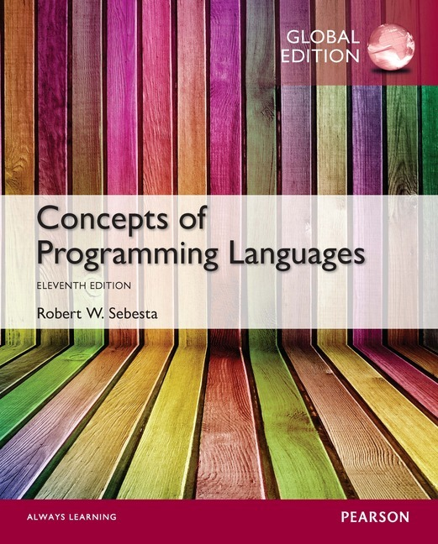
Chapter 1 Part 2
Preliminaries

Slide 2
Topics
Influences on Language Design
Language Categories
Implementation Methods
Programming Environments

Slide 3
Influences on Language Design
Computer Architecture
Languages are developed around the prevalent computer architecture, which is known as the von Neumann architecture
Programming Methodologies
New software development methodologies (e.g., object-oriented software development) led to new programming paradigms and by extension, new programming languages

Slide 4
Computer Architecture Influence
Best-known computer architecture: Von Neumann
Imperative languages are most dominant, because of von Neumann computers
Data and programs stored in memory
Memory is separate from CPU
Instructions and data are piped from memory to CPU
Basis for imperative languages
Variables model memory cells
Assignment statements model piping
Iteration is efficient, recursion is discouraged

Slide 5
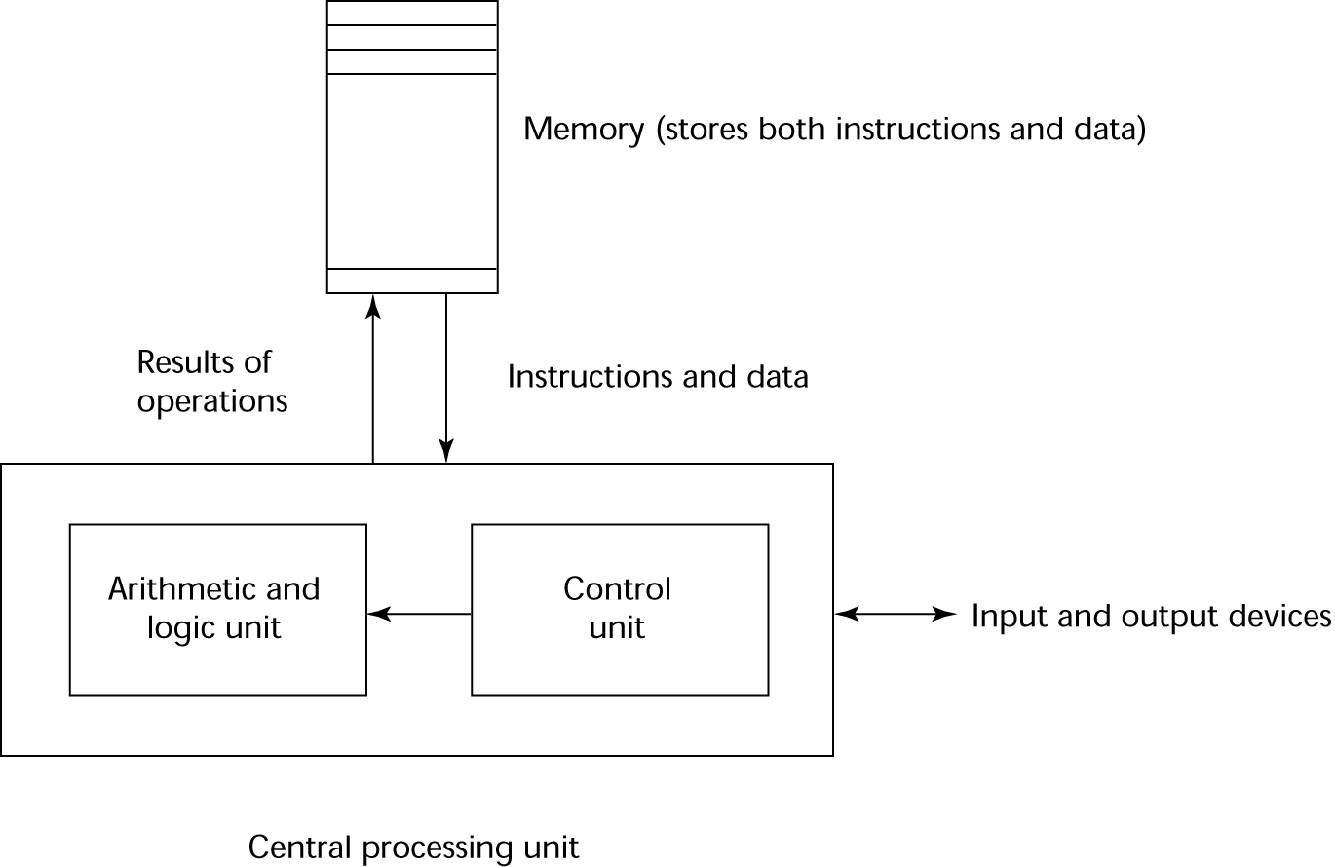
The von Neumann Architecture

Slide 6
Programming Methodologies Influences
1950s and early 1960s: Simple applications; worry about machine efficiency
Late 1960s: People efficiency became important; readability, better control structures
structured programming
top-down design and step-wise refinement
Late 1970s: Process-oriented to data-oriented
data abstraction
Middle 1980s: Object-oriented programming
Data abstraction + inheritance + polymorphism

Slide 7
Language Categories
Imperative
Central features: variables, assignment statements, iteration
Includes languages that support object-oriented programming
Includes scripting languages
Includes the visual languages
Examples: C, Java, Perl, JavaScript, Visual BASIC .NET, C++
Functional
Main means of computation: applying functions to parameters
Examples: LISP, Scheme, ML, F#
Logic
Rule-based (rules are specified in no particular order)
Example: Prolog
Markup/programming hybrid
Markup languages extended to support some programming
Examples: JSTL, XSLT

Slide 8
Implementation Methods
Compilation
Programs are translated into machine language
Use: Large commercial applications
Pure Interpretation
Programs are interpreted by another program known as an interpreter
Use: Small programs or when efficiency is not an issue
Hybrid Implementation Systems
A compromise between compilers and pure interpreters
Use: Small and medium systems when efficiency is not the first concern

Slide 9
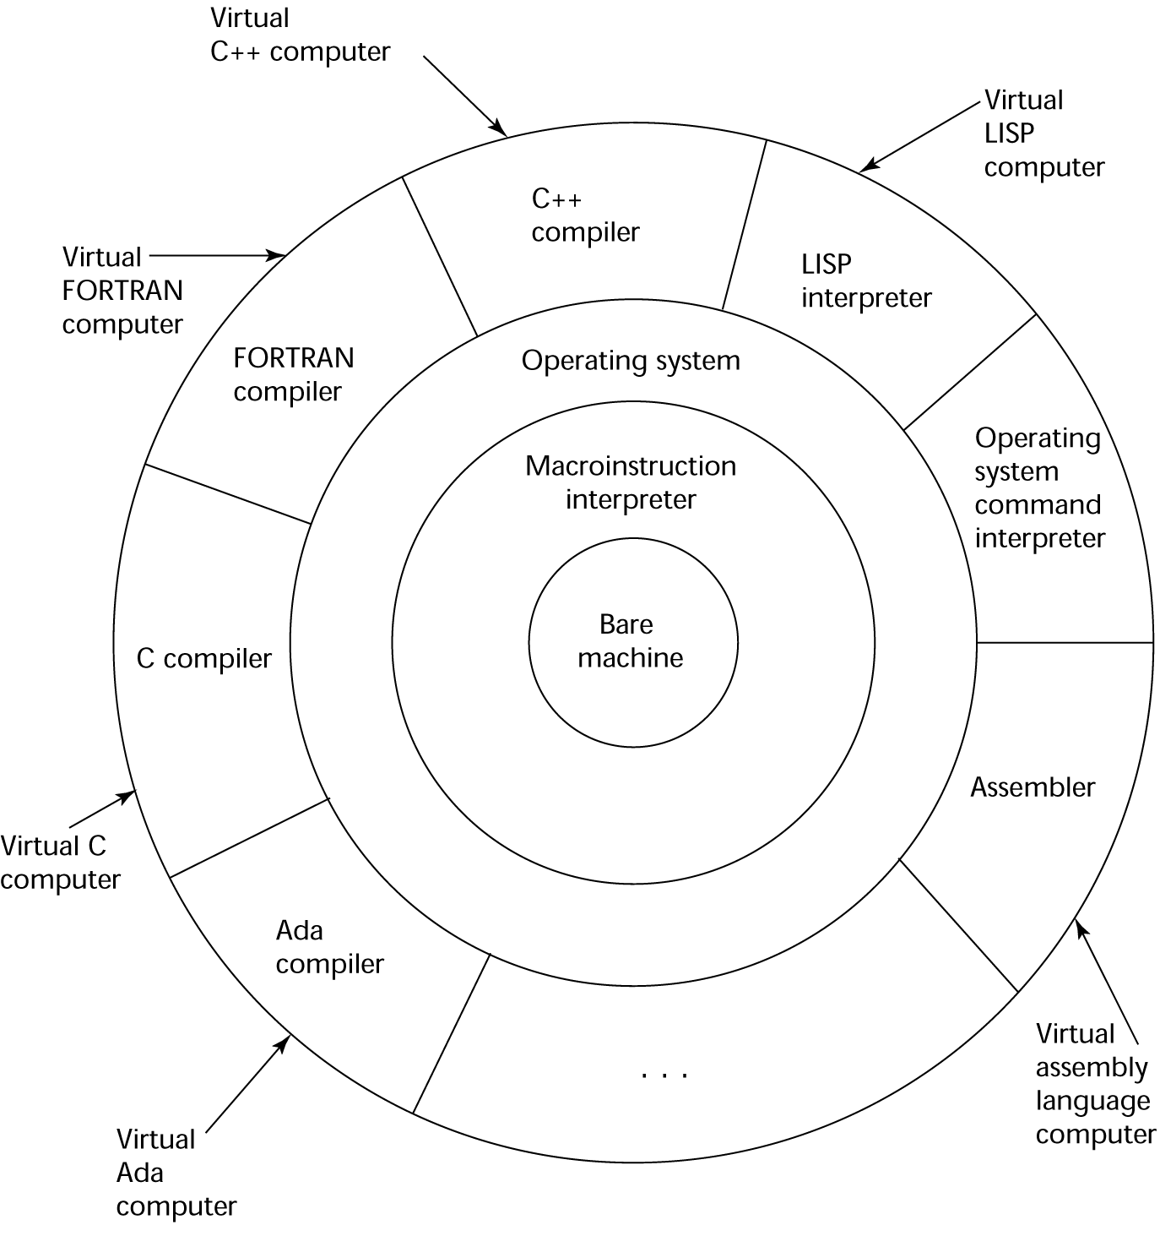
Layered View of Computer
The operating system and language implementation are layered over
machine interface of a computer

Slide 10
Compilation
Translate high-level program (source language) into machine code (machine language)
Slow translation, fast execution
Compilation process has several phases:
Lexical analysis
Converts source program characters into lexical units
Syntax analysis
Transforms lexical units into a parse trees
Parse trees represent the syntactic structure of program
Semantics analysis
Generate intermediate code
Code generation
Machine code is generated
Notes:
Additional compilation terminology
Load module (executable image)
The user and system code together
For example, I/O code provided by the OS
Linking and loading
The process of collecting system program units and linking them to a user program

Slide 11
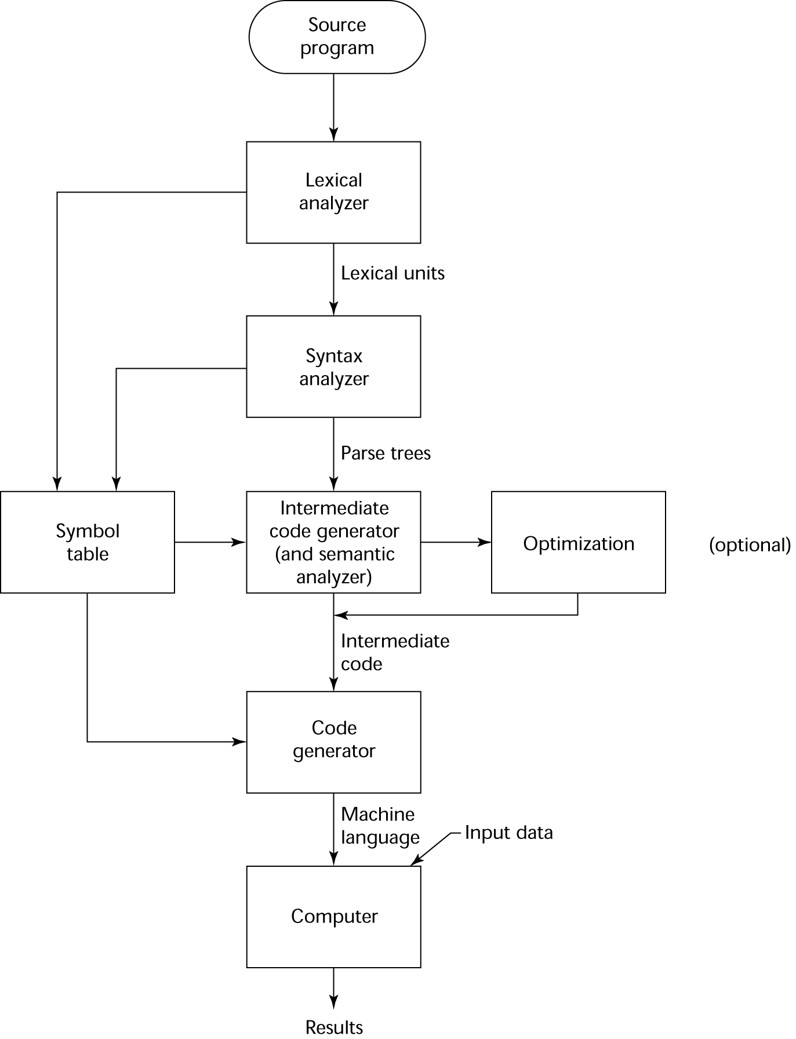
The Compilation Process

Slide 12
Pure Interpretation
No translation
Easier implementation of programs
Run-time errors can easily and immediately be displayed
Slower execution
10 to 100 times slower than compiled programs
Decoding high-level statements vs machine language
Repeated statement executions are repeatedly decoded
Often requires more space
Source program and symbol table are present at runtime
Now rare for traditional high-level languages
Significant comeback with some Web scripting languages (e.g., JavaScript and PHP)

Slide 13
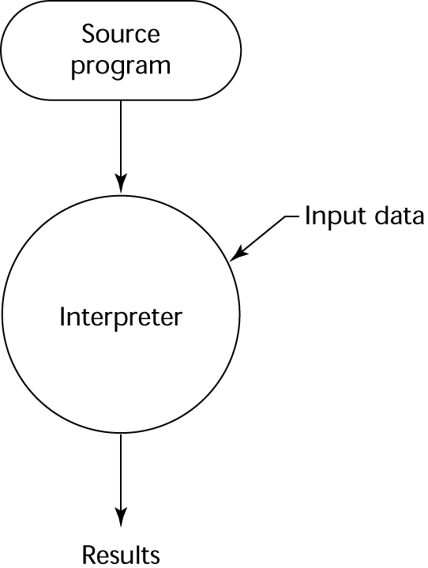
Pure Interpretation Process

Slide 14
Hybrid Implementation Systems
A compromise between compilers and pure interpreters
A high-level language program is translated to an intermediate language that allows easy interpretation
Faster than pure interpretation
Examples
Perl programs
Partially compiled to detect errors before interpretation
Typical Java implementations are hybrid
Intermediate form (byte code) provides portability to any machine that has a byte code interpreter and a run-time system (together, these are called the Java Virtual Machine)

Slide 15
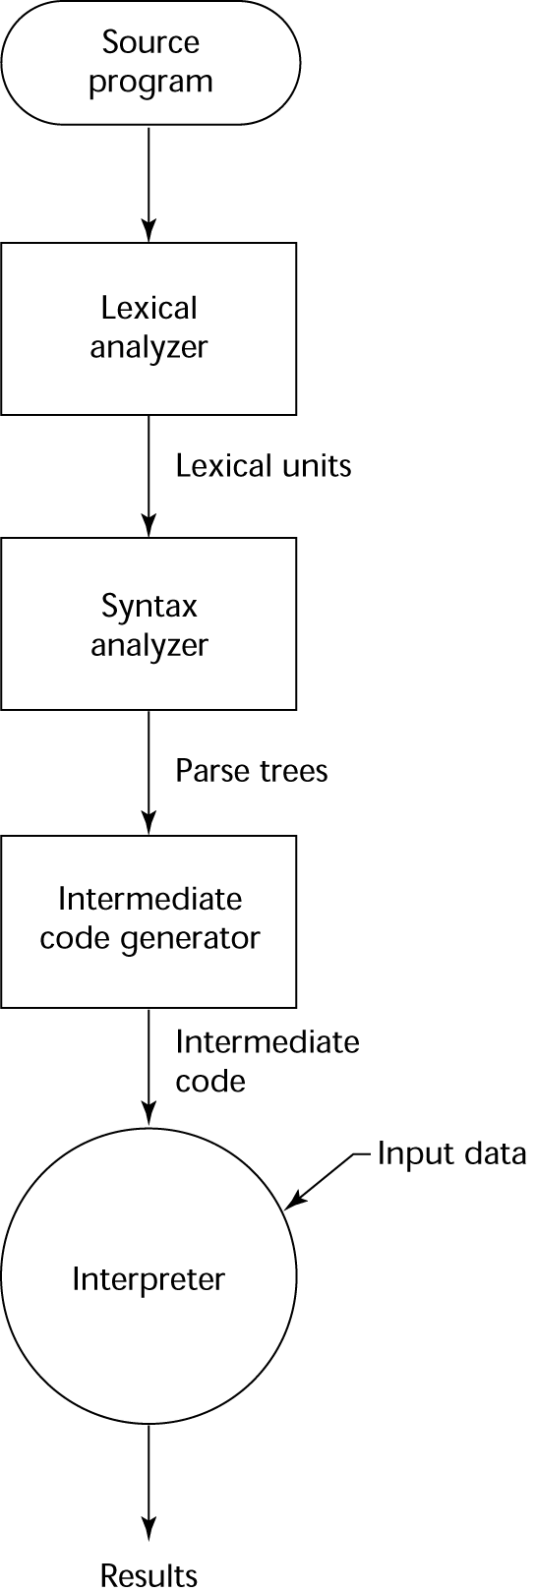
Hybrid Implementation Systems

Slide 16
Just-in-Time Implementation Systems
Initially translate programs to an intermediate language
Then compile the intermediate language of the subprograms into machine code when they are called
Machine code version is kept for subsequent calls
JIT systems are widely used for Java programs
The .NET languages implemented using JIT system
In essence, JIT systems are delayed compilers

Slide 17
Programming Environments
A collection of tools used in software development
UNIX
An older operating system and tool collection
Nowadays often used through a GUI (e.g. CDE, KDE, or GNOME) that runs on top of UNIX
Microsoft Visual Studio.NET
A large, complex visual environment
Used to build Web applications and non-Web applications in any .NET language
NetBeans
Similar to Visual Studio .NET, but intended for Web applications in Java

